Slide 1
AP Human Geography
The cultural landscape

Slide 2
What is geography?
Who can tell me what Geography is?
It is the scientific study of the location of people & activities across the earth and the reasons for their distribution.
Eratosthenes (Greek Scholar) first to say Geo-graphy
Geography asks two questions:
WHERE things are and
WHY they are there
-Geographers organize things by place
-Historians organize things by time.
Something happening here can affect what’s happening there.

Slide 3
Globalization vs. local diversity
Globalization pulls the world together
Internet has made us a global community
Local Diversity pushes us want to be unique
Express cultural traditions and economic practices
This push and pull can lead to conflict, what could they be?
Political, economic, and pollution to name a few

Slide 4
BIG 2: Where and why
-Where are people and activities found on Earth?
-Why are they found there?
HUMAN ASPECT: (Our focus)
Religions, cities, businesses
PHYSICAL ASPECT: (Can’t Forget)
Climate, land formation, vegetation

Slide 5
Don’t forget about physicality
Why should we not forget about the physical aspect of Geography?
All physical aspects affect the human side.
People and their environments
Examples???

Slide 6
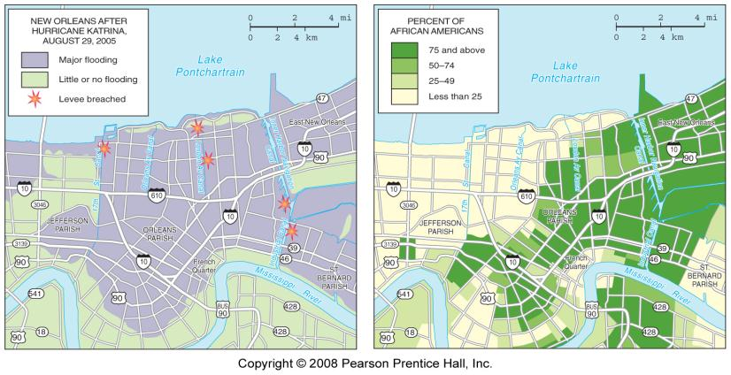
Hurricane katrina (2005)
Fig. 1.1: Most of the area of New Orleans flooded after Hurricane Katrina was majority African American. Physical and political geography intersect in analyzing the impacts of the natural disaster

Slide 7
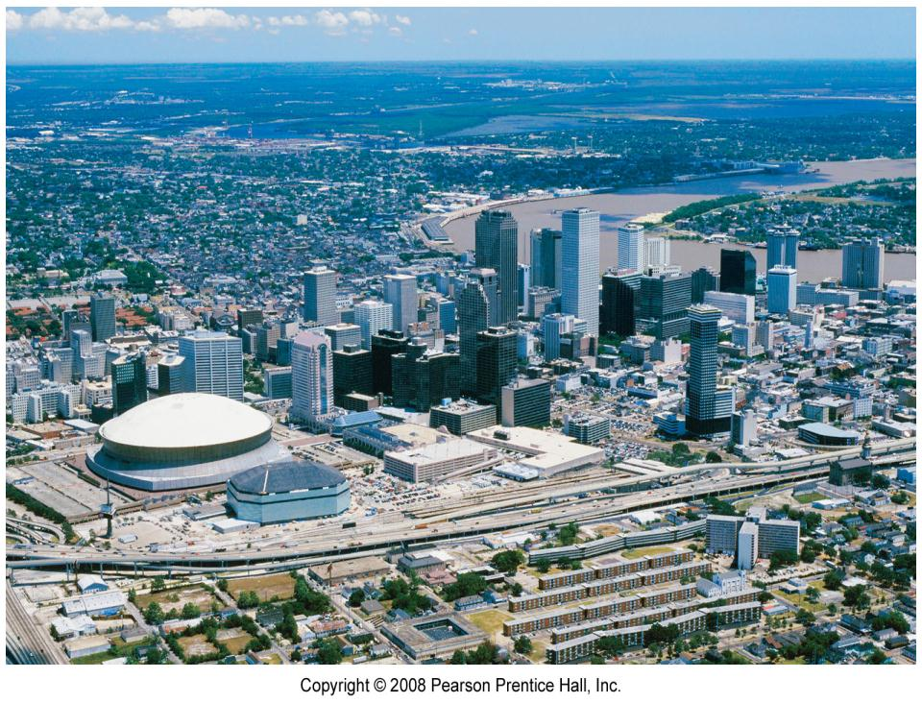
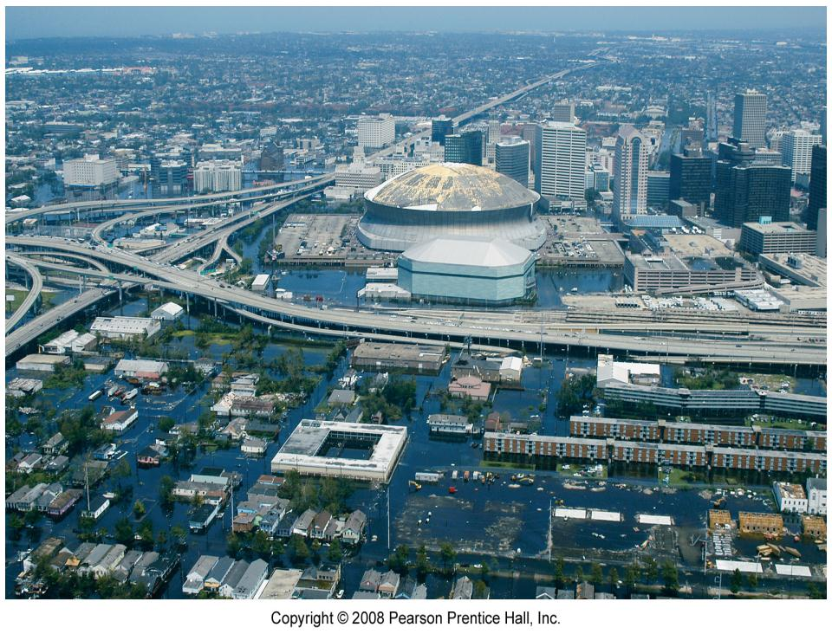

Slide 8
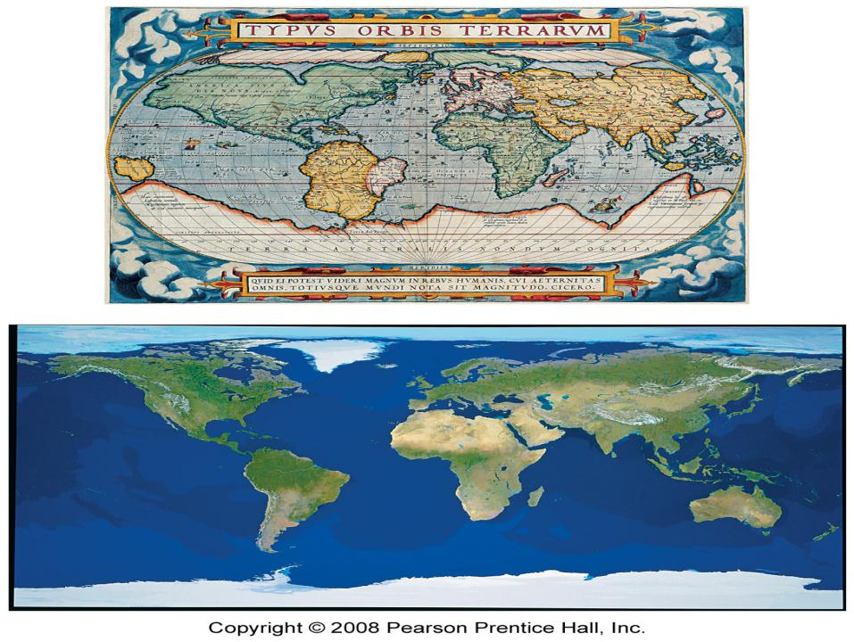
Geography’s most important tool?
MAP: 2-D or flat-scale model of E’s surface, or a portion of it.
Stores reference material and communication geographic info.
Cartography: science of mapmaking

Slide 9
Maps
Early Mapmaking
Babylonians ~ 2300 B.C.
Aristotle demonstrates E was spherical (384-322 B.C.)
Roman & Greek Contributions
Map Scale
Large scale = less detail, Smaller scale = more detail
Scale: relationship of a feature’s size on a map to its size on E
Fraction/ratio, written, bar scale

Slide 10
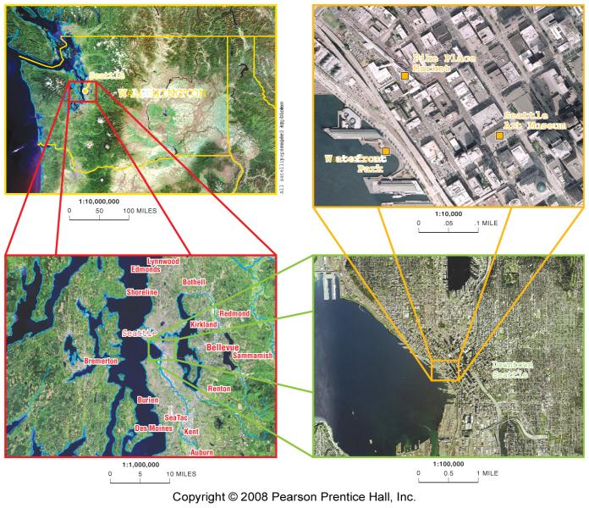
Scale Differences: Maps of Washington State

Slide 11
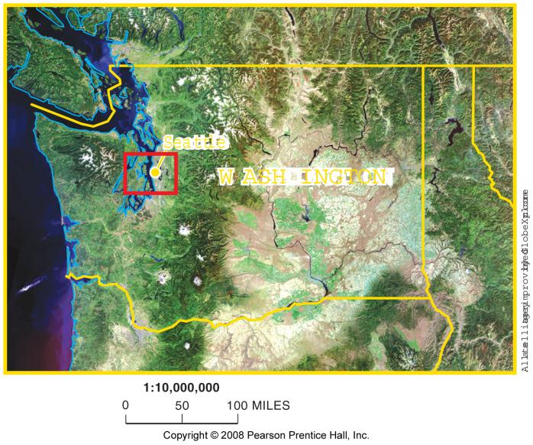
Washington State (1:10 million scale)

Slide 12
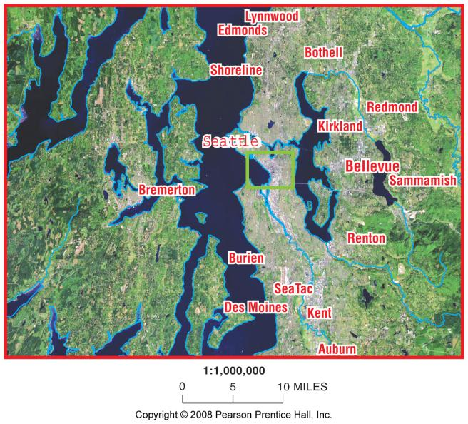
Western Washington (1:1 million scale)

Slide 13
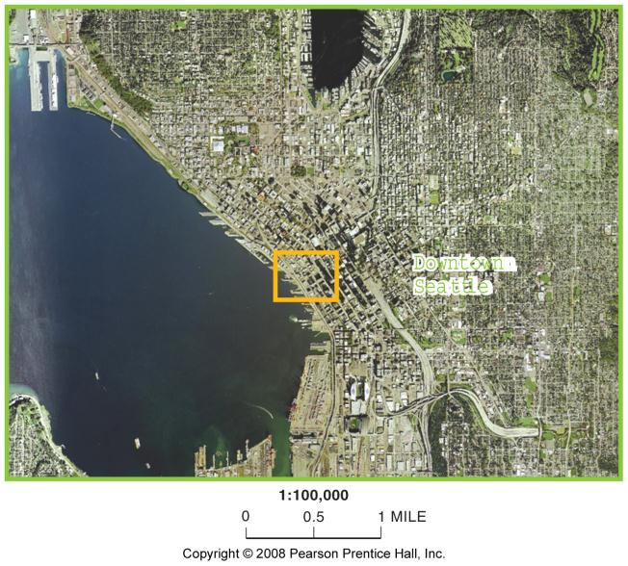
Seattle Region (1:100,000 scale)

Slide 14
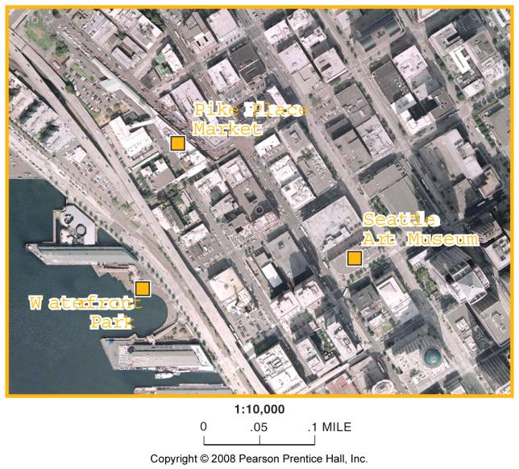
Downtown Seattle, Washington (1:10,000 scale)

Slide 15
Maps
Projection: method of transferring locations on E’s surface to a flat map.
4 types of distortion
1. shape: elongated or squat
2. distance: + or –
3. relative size: appears bigger than reality
4. direction: one place to another

Slide 16
U.S. LAND ORDINANCE OF 1785
Land Ordinance of 1785: divided country into townships and ranges.
For sale of land to western settlers
Township: 6x6 miles square
Principal meridians: north|south lines dividing townships
Baselines: east—west lines dividing townships
Sections: 36 in each township (1x1 mile)

Slide 17
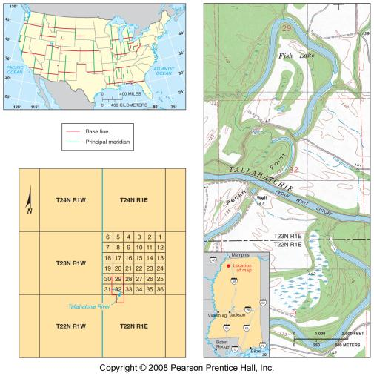
Township & Range System in U.S.
Fig. 1-4: Principal meridians & east-west baselines of the township system. Townships in northwest Mississippi & topographic map of the area.

Slide 18
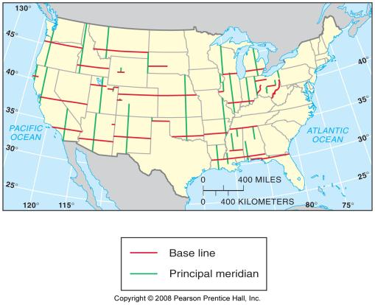
Principal Meridians
& Baselines

Slide 19
CONTEMPORARY TOOLS
GIS: (Geography Information Systems)- the position of any object on E can be measured and recorded with mathematical Precision
What can GIS be used for or prevent?
-Info can be stored in layers (like Photoshop)
Boundaries, water, roads, climates, etc.
-Shows relationships among different info as well
Farming practices, H2O/O, vegetation, development

Slide 20
Layers of a GIS
Fig. 1-5: A geographic information system (GIS) stores information about a location in several layers. Each layer represents a different category of information.

Slide 21
CONTEMPORARY TOOLS
Remote Sensing: collection of data about E’s surface from an orbiting satellite
Essentially a grid containing many rows of pixels
Primarily used for environmental issues
-What do you think a scanner can see from space…how big?
GPS: (Global Positioning System): determines the precise position of something on E
Google Maps, Yelp, etc.

Slide 22
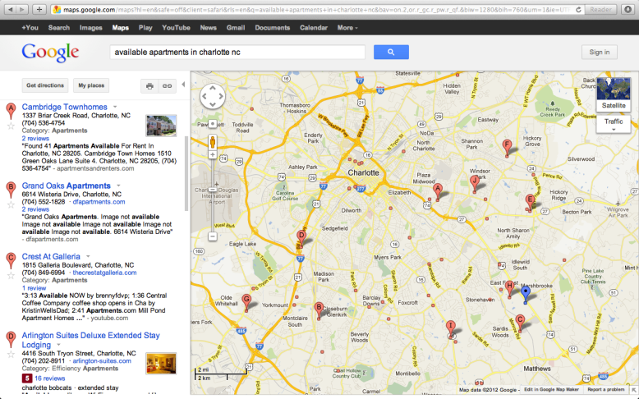
Google Map Available apts. In charlotte

Slide 23
Why is each point on earth unique?
PLACE: Unique location of a feature
REGIONS: Areas of unique characteristics
-The difference between these concepts is a matter of scale.
A place is a point
Region is an area
Strong sense of place…name some, what makes you remember?
Helps geographers explain similarities, differences, and changes across E

Slide 24
Place
Location: position of something that occupies E’s surface
4 ways to ID location; Place name, site, situation, and mathematical location.
Place Names
Toponym: name given to a place on E
-person, religion, happenstance, environment
Site: location of a place, physical character of a place
Climate, water sources, topography, soil, vegetation

Slide 25
Place
Site: location of a place, physical character of a place
Climate, water sources, topography, soil, vegetation
-What would you consider when choosing a site before settling?
Hilltop, valley, water source, wooded, plains…?
-Humans can modify characteristics of a site.

Slide 26
Site: Lower Manhattan Island
Fig. 1-6: Site of lower Manhattan Island, New York City. There have been many changes to the area over the last 200 years.

Slide 27
Place
Situation: location of a place relative to other places
Helps find an unfamiliar place and compare it to a familiar one
-Giving directions by using landmarks
-Situation helps us understand importance of location
Singapore=center for trade in SE Asia because it is near Strait of Malacca.

Slide 28
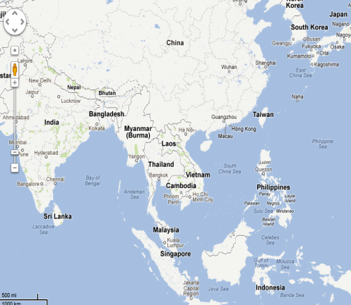
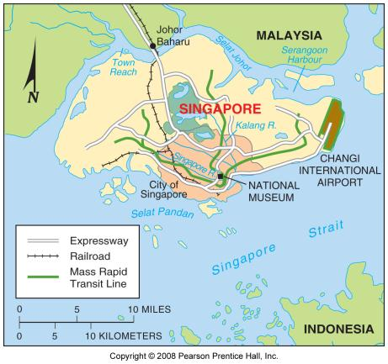
Singapore

Slide 29
Place
Mathematical Location
Meridian: arc drawn between N & S poles
Parallel: circle drawn around the globe parallel to equator
Prime Meridian: 0° longitude (Greenwich, Eng.)
Each meridian is ID’ed according to its longitude
Important for telling time
Latitude: indicates location of parallel
Equator is 0°, N Pole 90°, S Pole 90°
International Date Line: 180°Long. Move the clock back 24 hours moving East, ahead if moving West

Slide 30
World Geographic Grid
Fig. 1-8: The world geographic grid consists of meridians of longitude and parallels of latitude. The prime meridian ( 0º) passes through Greenwich, England.

Slide 31
World Time Zones
Fig. 1-9: The world’s 24 standard time zones each represent about 15° of longitude. They are often depicted using the Mercator projection.

Slide 32
Regions: areas of Unique Character
“Sense of place”
-Could be larger than a specific point, i.e. Charlotte, South East
Cultural Landscape: combination of cultural features.
Language, religion, agriculture, climate, vegetation,etc regional studies
-Regions have distinctive landscapes that result from social relationships and physical process
-Human & environmental character=Uniqueness

Slide 33
Regions: areas of Unique Character
3 types of Region
Formal, functional, and vernacular
Formal: area within which everyone shares in common one or more distinct characteristics.
Language, crop product, climate
North Carolina, wheat belt, political affiliation
CAUTION!
Recognize diversity of culture, economics, and environmental factors while making generalizations.

Slide 34
Presidential Election, 2004 Results by State

Slide 35
Regions: areas of Unique Character
Functional: (nodal) area organized around a node or focal point
Character chosen to define functional region dominates a central focus and diminishes outward.
-A region is tied to a central point
Transportation or economic/functional assoc.

Slide 36
Formal and Functional Regions
Fig. 1-11: The state of Iowa is an example of a formal region; the areas of influence of various television stations are examples of functional regions.

Slide 37
Regions: areas of Unique Character
Vernacular: perceptual region, place that people believe exists as part of their cultural ID.
Mental map: an internal representation of a part of E
-personal impression of what a place is like.
i.e. South=environmentally, culturally and economically different than other regions in U.S.

Slide 38
Vernacular Regions
Fig. 1-12: A number of features are often used to define the South as a vernacular region, each of which identifies somewhat different boundaries.

Slide 39
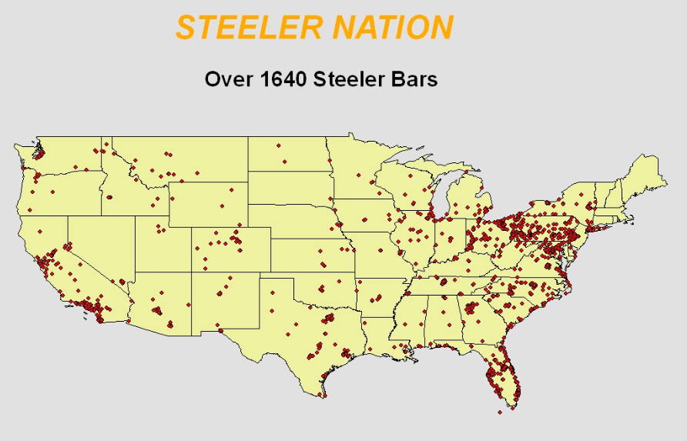
Spatial association
Different conclusions reached based on its scale
-Consider Panther fans, vary’s widely among scales with in U.S.
In NC, probably large % of fans
SE U.S. % shrinks
Entire U.S. even less
STEELER NATION!

Slide 40
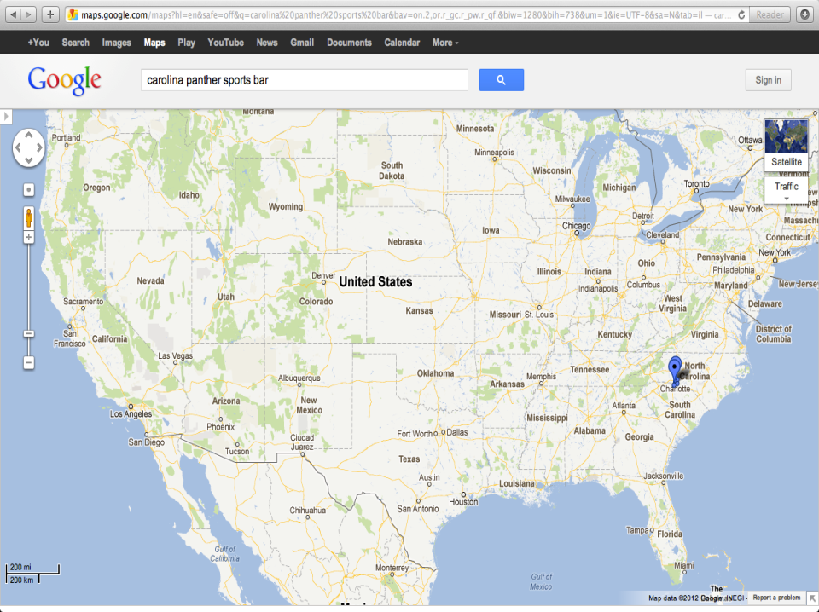

Slide 41
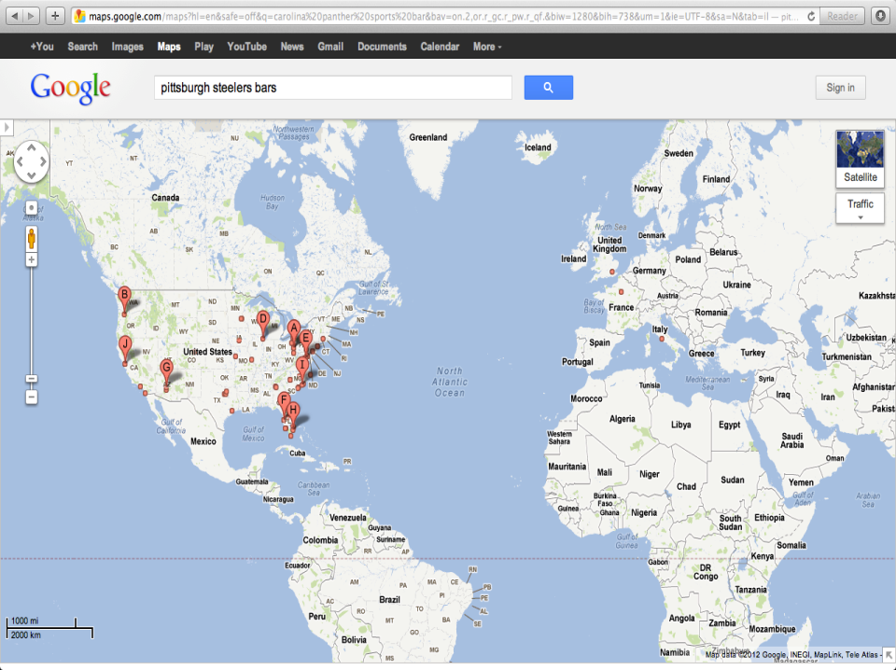

Slide 42
Regional integration of culture
Culture: body of customary beliefs, material traits, and social forms that constitute the distinct tradition of a group of people
Job of the Geographer? 2 big questions
Culture-Cultus Latin for “to care for”
To care about- adore, worship, as cult
To take care of- nurse or look after, as in cultivate

Slide 43
Regional integration of culture
What people care about:
-Why customary ideas, beliefs, and values of people produce distinctive culture in a particular place.
Language (chp.5) How do we use it?
Religion (chp.6) How does it impact us?
Ethnicity (chp.7) What does it encompass? Conflict?

Slide 44
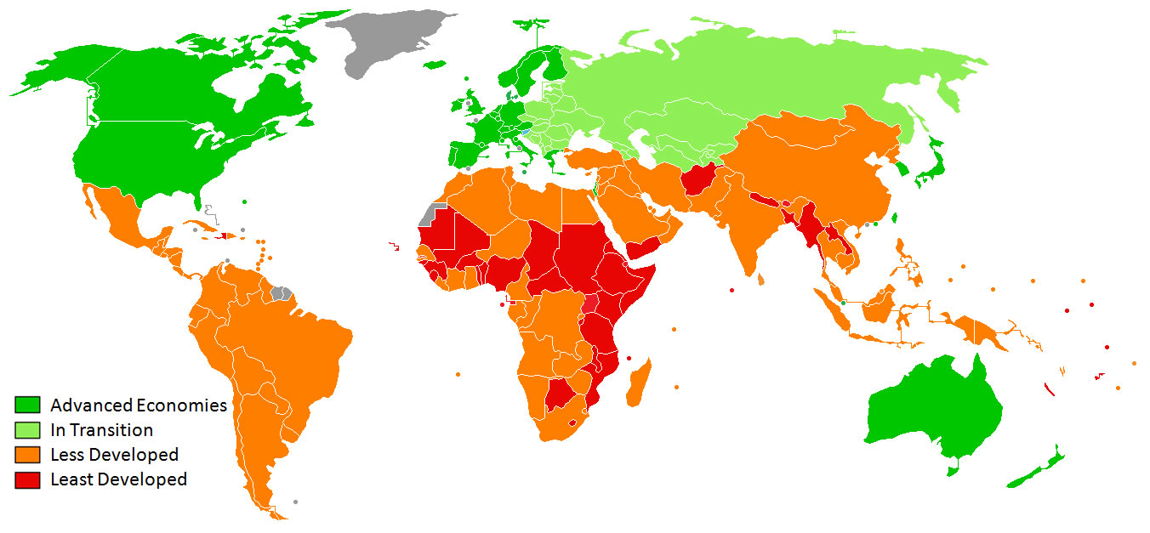
Regional integration of culture
What people take care of:
-Material wealth; clothing, food, and shelter
World divided into regions:
More developed economically (MDC)
Less developed economically (LDC)

Slide 45
Cultural ecology: Integrating culture and environment
Cultural Ecology: geographic study of human-environment relationships
Importance given to relationships between culture and natural environment.
Environmental determinism: how the physical environment caused social development
What do you think is the major determinant of civilization?

Slide 46
Cultural ecology: Integrating culture and environment
Human and Physical Factors:
Possibilism: physical environment may limit some human activity, but people can adjust to the environment.
Rejects environmental determinism
-What do you think?
Resources: substances that are useful to people, economically/technologically feasible to access, and socially acceptable to use.
-gas/oil, coal, wind, nuclear, solar?

Slide 47
Cultural ecology: Integrating culture and environment
Human and Physical Factors:
-Climate affects human activity
Crop selection, i.e. wheat and rice
-Wealth influences modification of environment
Tractorless farmer, air conditioner/insulation

Slide 48
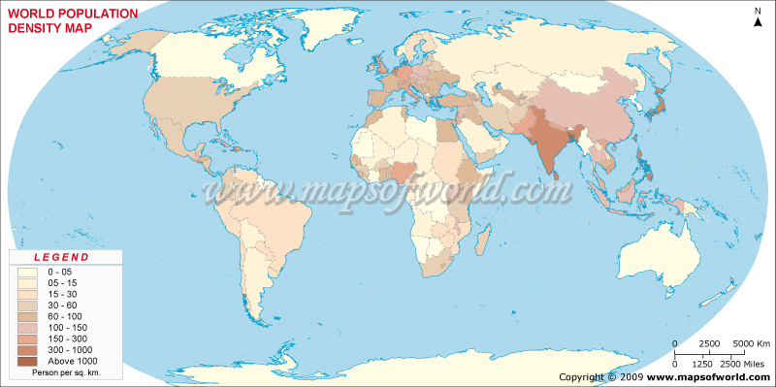
Cultural ecology: Integrating culture and environment
Physical Processes: Climate
5 climate regions: Tropical, Dry, Warm Mid-Latitude, Cold Mid-Latitude, & Polar
-Where are most people distributed?
-Climate heavily influences human activities

Slide 49
World Climate Regions
Fig. 1-14: The modified Köppen system divides the world into five main climate regions.

Slide 50
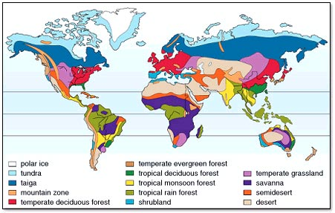
Cultural ecology: Integrating culture and environment
Physical Processes: Vegetation
-4 Major Biomes: Forest, Savanna, Grassland, & Desert

Slide 51
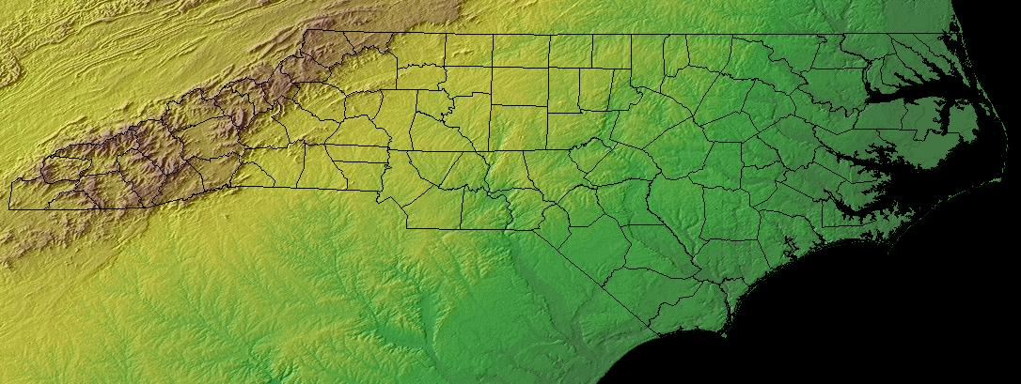
Cultural ecology: Integrating culture and environment
Physical Processes: Soil
-Main concern is destruction of soil
Erosion and depletion of nutrients
Physical Processes: Landforms
-Geomorphology-study of E’s landforms
Explains population distribution and economic act.
Topographic maps

Slide 52
God made earth, but the Dutch made the Netherlands
Massive human modification
Half of the country is below sea level
2 types of modifications:
Polder: land created by draining water (13th C)
16% of the country’s land area
Dike: dams or floodgates

Slide 53
Environmental Modification in the Netherlands
Fig. 1-15: Polders and dikes have been used for extensive environmental modification in the Netherlands.

Slide 54
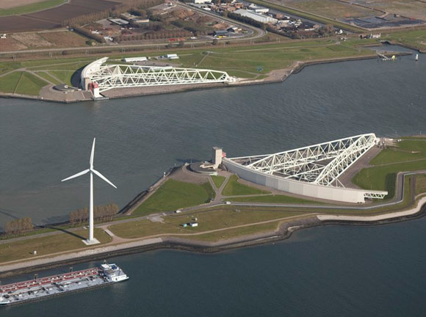
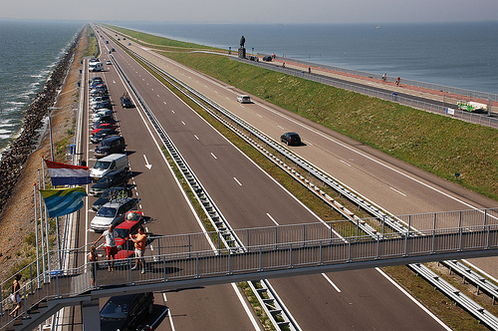
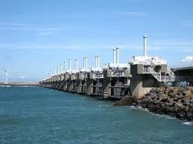

Slide 55
Environmental Modification in Florida
Fig. 1-16: Straightening the Kissimmee River has had many unintended side effects.

Slide 56
C-38 Canal Florida
The canal has carried water with agricultural runoff and pollution into Lake Okeechobee

Slide 57
Florida’s environmental modifications
Human modifications:
Seawalls and jetties
U.S. Army Corp of Engineers
Levee around Lake Okeechobee
Divided 1/3 of N Everglades
Canaled Kissimmee River
Dames and levees near Miami and Ft. Lauderdale
Opened A TON of hectares for farm land and sugarcane
Water pollution from pesticides and cattle

Slide 58
Why are different places similar?
Scale: From Local to Global
Local scale= unique features
Global scale= broad patterns
Helps explain human actions at all scales
Certain religions settle certain places
Corps. Located in specific places
Why…?

Slide 59
Globalization of economy
Globalization: force or process that involves the entire world and results in making something worldwide in scope
World is “shrinking”
-Almost everyone knows what a TV, telephone, and car is/are
People are more connected now than ever before
More uniform, integrated, and interdependent

Slide 60
Globalization of economy
Transnational corporation: (multinational corp.) researches, operates factories, and sells products in many countries, not just where its headquarters are located
-Most activities influenced by decisions made elsewhere (demand/market)
-Technology allows global business
-Success of the corps. depends on assessment of location
What are California, Midwest, Middle East, etc known for producing?

Slide 61
Globalization of the Economy
Fig. 1-17: The Denso corporation is headquartered in Japan, but it has regional headquarters and other facilities in North America and Western Europe.

Slide 62
Globalization of culture
Fast food restaurants look the same in every location, why?
-Language and Religion
English and Christianity/Islam
-The more awareness of elements of global culture, the more our local beliefs, forms and traits are threatened
Good or bad?
-Do you think culture is still celebrated?
Can cultural differences bring unrest?
Egypt, Libya, Bahrain, al-qaeda, 9/11

Slide 63
Space: distribution of features
Spatial thinking is the most fundamental skill a geographer possess to understand the arrangement of objects across large surfaces.
-Think of the arrangement of people and activities in space and try to understand why are there.
When and Why?

Slide 64
Space: distribution of features
Distribution: arrangement of a feature in space
Three main properties: Density, Concentration, and Pattern
Density: frequency with which something occurs in space
Measuring anything; people, houses, cars…
Arithmetic density: total # of objects in an area
Commonly compares countries pop.
-Large pop. may not lead to high density (China)
-Poverty is unrelated to high population (Dutch)

Slide 65
Distribution: Density, Concentration, & Pattern
Fig. 1-18: The density, concentration, and pattern (of houses in this example) may vary in an area or landscape.

Slide 66
Space: distribution of features
Concentration: extent of a feature’s spread over space
Close together=clustered
Far apart=dispersed
-Concentration is different than density

Slide 67
Density and Concentration of Baseball Teams, 1952 & 2007
Fig. 1-19: The changing distribution of North American baseball teams illustrates the differences between density and concentration.

Slide 68
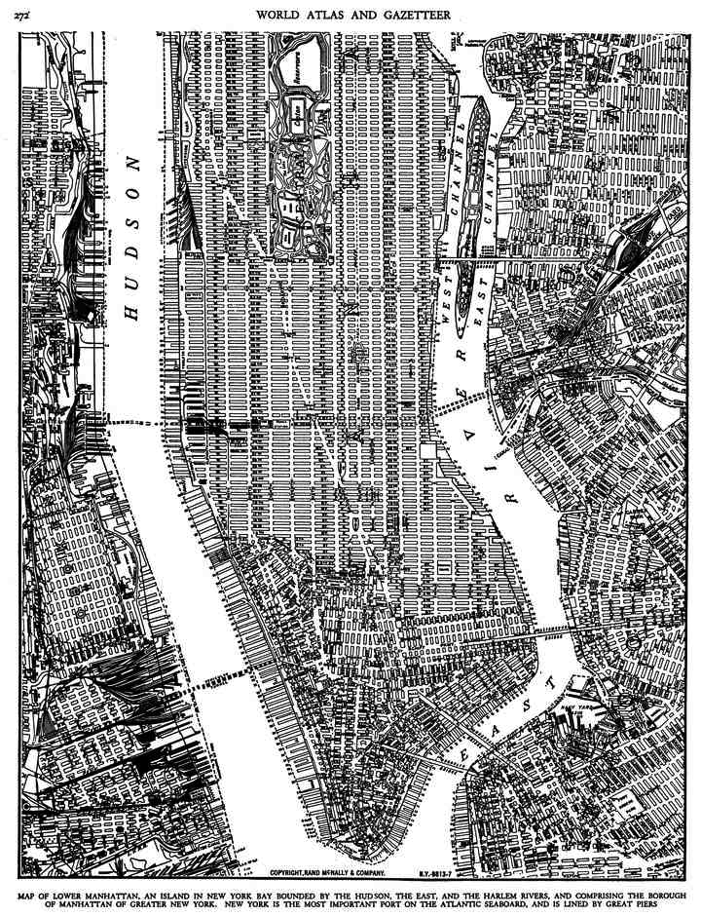
Space: distribution of features
Pattern: the geometric arrangement of objects in space
Often linear distribution or in a square/rectangle grid
- May be irregularly distributed
- Land Ordinance of 1785
- “Smiley face bomber”

Slide 69
Gender and ethnic diversity in space
The “All-American” family
Make up less than ¼ of American households
How is the location of the home selected?
Most U.S. neighborhoods residents are virtually all white or people of color
Segregation persists because people want to reinforce their cultural identity by living near people of similar backgrounds
Cultural identity is a service of pride
These factors determine who we interact with
Why people sort themselves out in space and move across landscapes

Slide 70
Connections between places
Try and make connections among places and regions
Space-Time compression: the reduction in the time it takes to diffuse something to a distant place, as a result of improved communications and transportation systems
Time it takes for something to get from place A to B
Distant places seem less remote
How can this promote rapid change?
Culture and economy reach other places much quicker

Slide 71
Space-Time Compression, 1492-1962
Fig. 1-20: The times required to cross the Atlantic, or orbit the earth, illustrate how transport improvements have shrunk the world.

Slide 72
Airline Route Networks
Fig. 1-21: Continental Airlines, like many others, has configured its route network in a “hub and spoke” system.

Slide 73
Spatial interaction
People used to have to relocate to spread culture
How do we spread culture now?
TV, cameras, computers allow us to do it instantly
When places are connected through a network, geographers call it Spatial Interaction
Name some Networks
NBC, SouthWest, Greyhound, ?
Interaction can have barriers…name some
Ocean, desert, language, religion
Distance Decay: the diminishing importance and eventual disappearance of something with increasing distance.

Slide 74
Diffusion
Diffusion: is the process by which a characteristic spreads across from one space to another over time
Communication and transportation networks
People in more than one region may improve/modify an idea at the same time but in different ways
Place where innovation originates is a hearth
How do hearths emerge?
Try something new, allocate resources to nurture the innovation
An idea may originate independently in more than one hearth
Hearths may emerge in 2 regions, 2 groups modify a shared concept 2 different ways

Slide 75
Diffusion
For a “person, object, or idea” to have interaction with “ “ in other regions…what must occur?
2 types of diffusion
Relocation: spread of an idea → physical movement of people from one place to another
Carry culture; language, religion, ethnicity
What primary languages in the U.S. and why?
AIDS

Slide 76
AIDS Diffusion in the US, 1981-2002
Fig. 1-22: New AIDS cases were concentrated in three nodes in 1981. They spread through the country in the 1980s, but declined in the original nodes in the late 1990s.

Slide 77
New AIDS Cases, 1981 (per 100,000 population)

Slide 78
New AIDS Cases, 1993 (per 100,000 population)

Slide 79
New AIDS Cases, 2002 (per 100,000 population)

Slide 80
Cumulative AIDS Cases, 1981-2002

Slide 81
Diffusion
Expansion: spread of a feature from one place to another in a snowballing process
May result from one of 3 things:
Hierarchical diffusion
Contagious diffusion
Stimulus diffusion
Hierarchical: spread of an idea from persons/nodes of authority or power to other persons or places
Examples?

Slide 82
diffusion
Contagious: rapid, widespread diffusion of a characteristic throughout the population
Diseases; influenza, STD’s, AIDS
Ideas; Internet (WWW) ?
Stimulus: spread of an underlying principal, even though a characteristic itself fails to diffuse
Apple vs IBM early 1990’s
Expansion diffusion occurs much more rapidly now then in the past

Slide 83
Diffusion of culture and economy
Transportation and communication rapidly diffuse raw materials, goods, services, and capital from nodes of origin to other regions
Autoworker in Detroit → decisions made in Mexico City or Tokyo
Global culture and economy based in 3 core hearth regions
North America 2. Western Europe 3. Japan
Advanced technology & capital to buy and invest goods/services
The increasing gap in economic conditions between regions in core and periphery regions as a result of the globalization of the economy is known as uneven development

